Slide 1
SEO Webinar
Mike Bazhutin & Stijn Hendrikse
Presented by 1
Wednesday May 20th , 2015

Slide 2



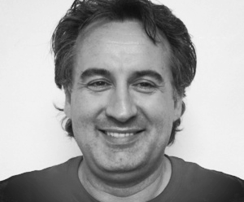


Introduction
Stijn Hendrikse – CEO MightyCall
“SaaS Marketing veteran with many bruises and some bragging rights”
stijnhendrikse | @stijnh1 | sh@mightycall.com

Slide 3
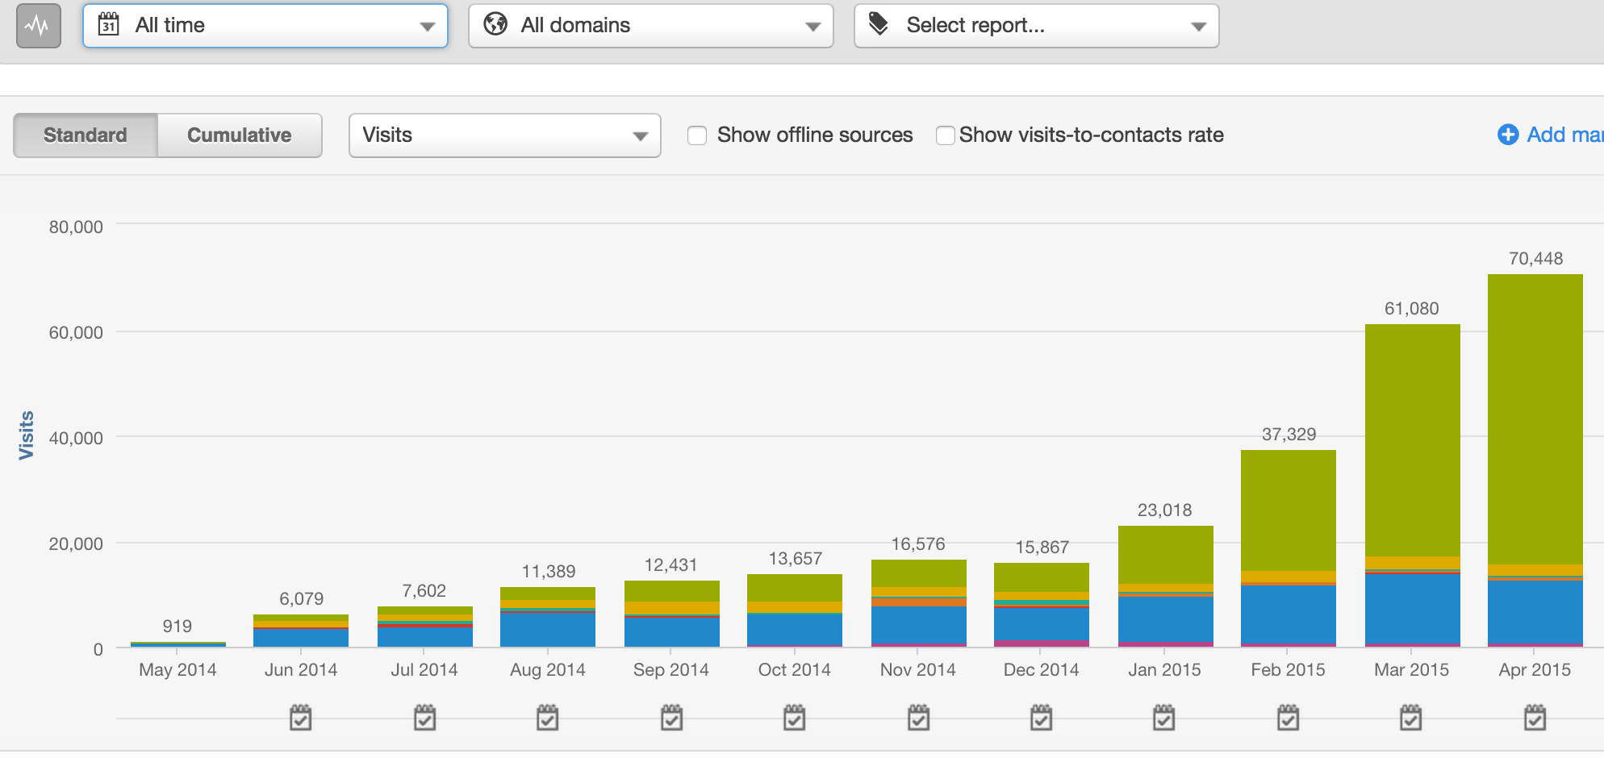
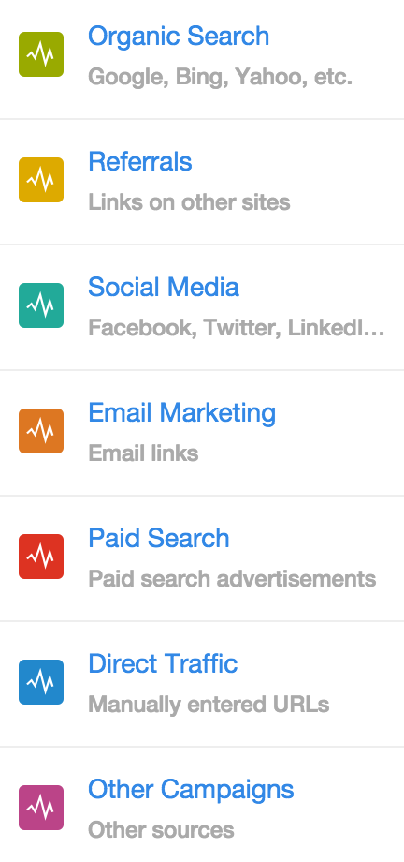

Slide 4
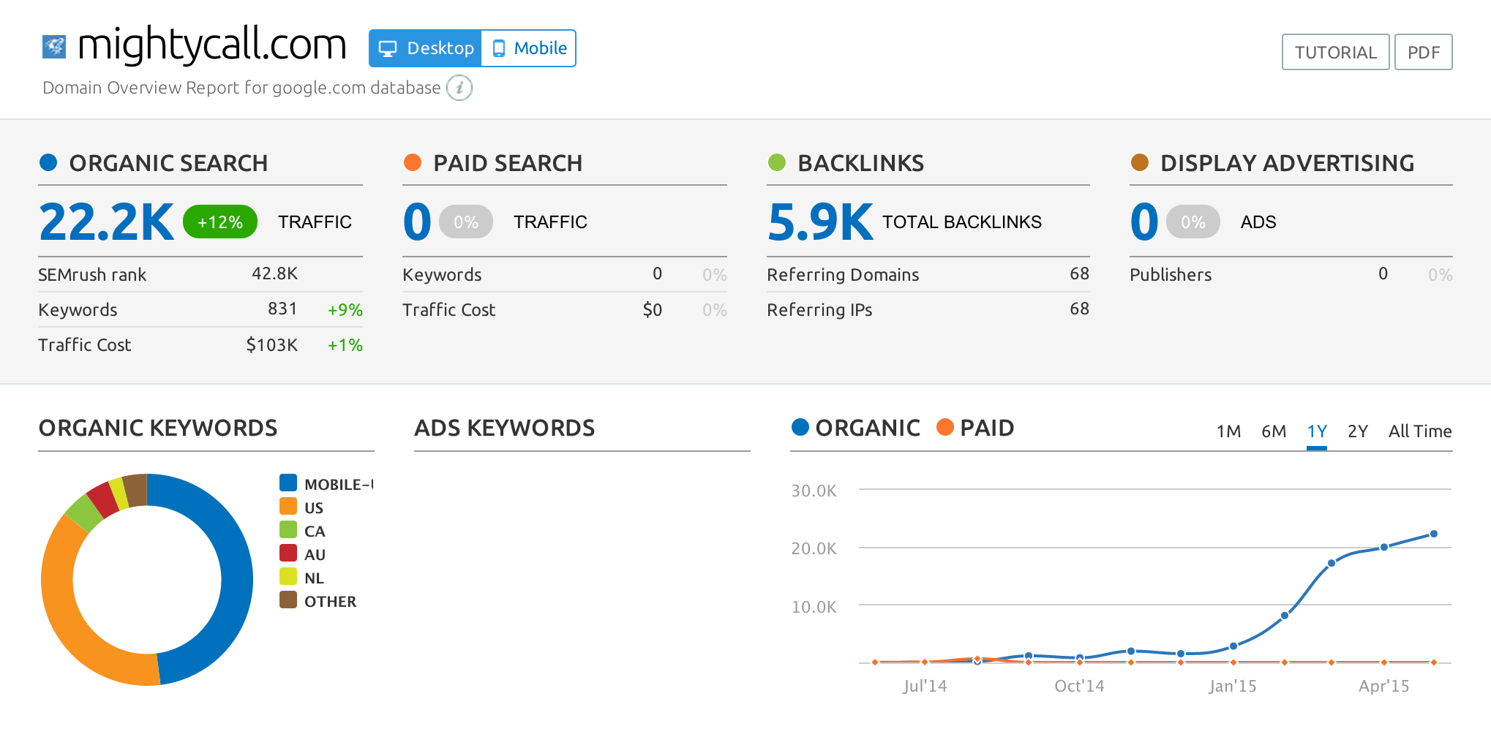
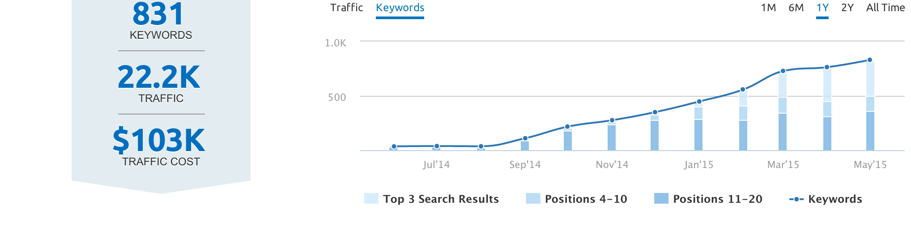
Notes:
Why am I talking to you today? We experiences something cool at MightyCall that might be worth sharing

Slide 5
So what did we do?
We struck a new balance.

Slide 6
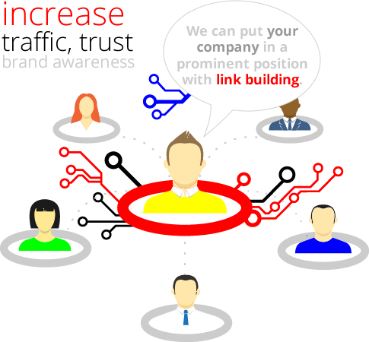


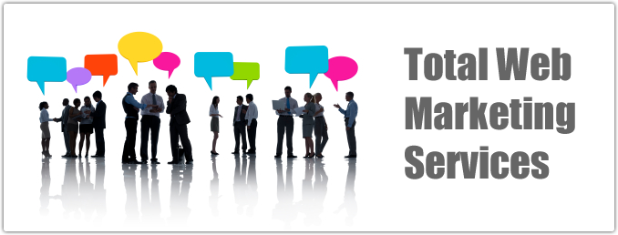



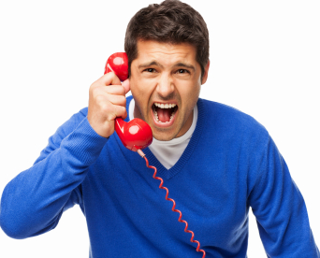
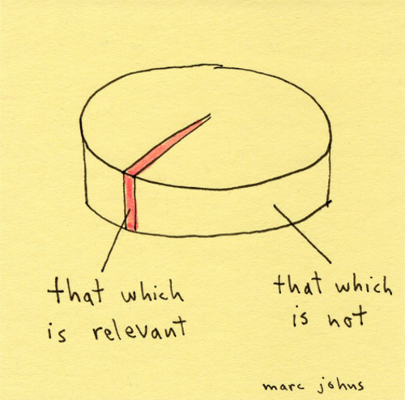
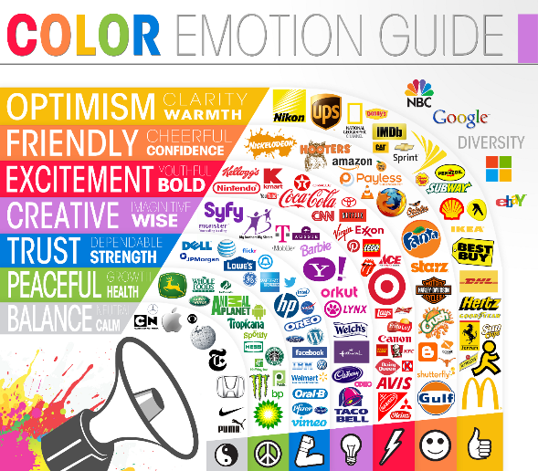

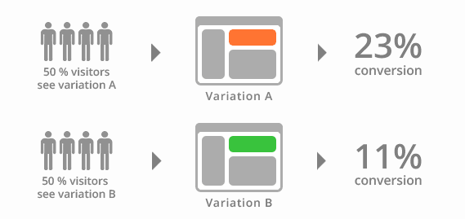


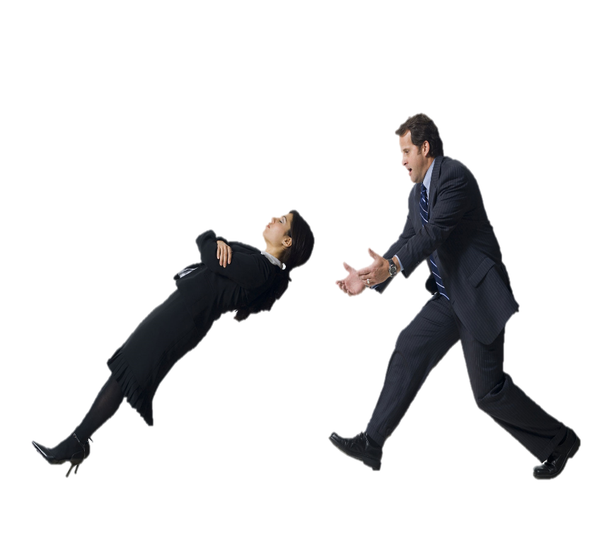
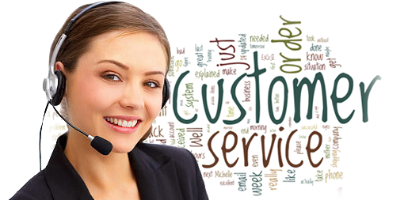
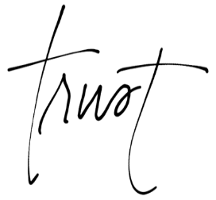
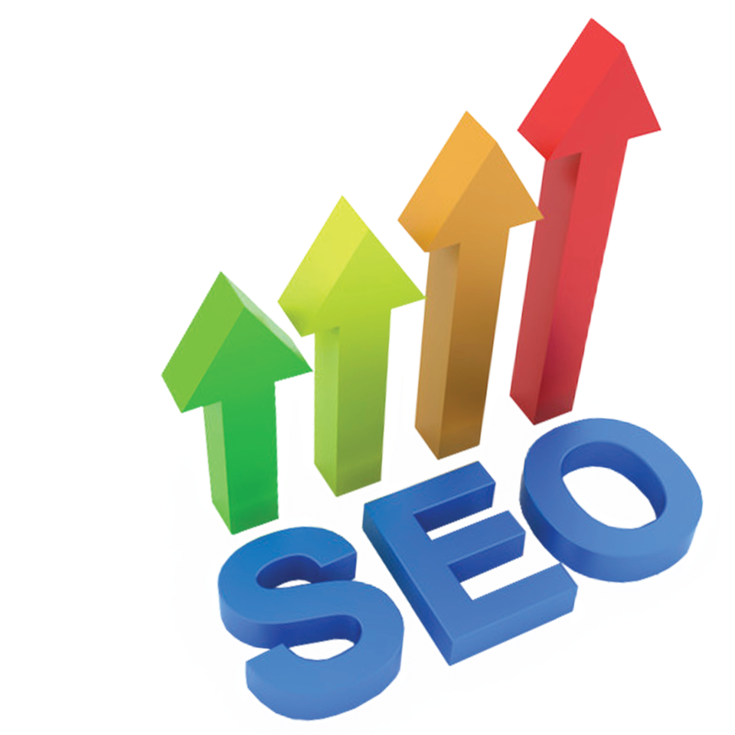

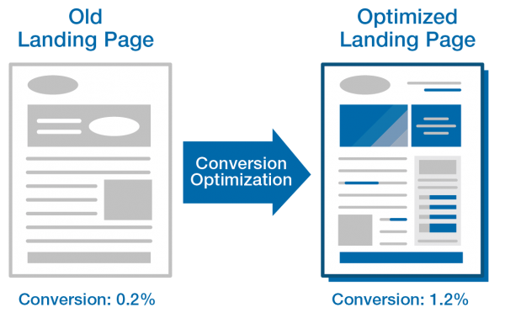


Growth ➔
Time ➔

Slide 7
MightyCall Focus in 2014-2015
Growth ➔
Time ➔

Slide 8
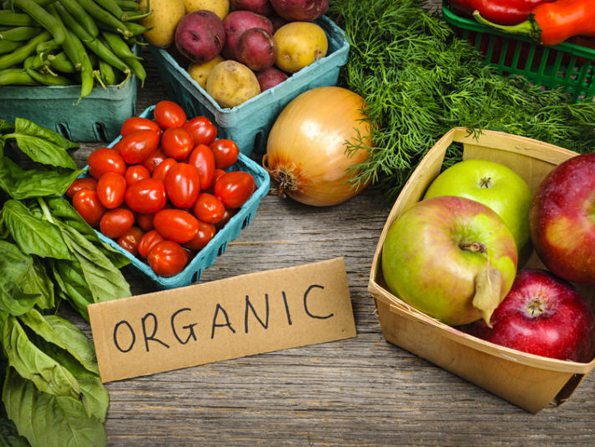
Organic vs. Paid – New Rules
Relevance is King
Reputation is Queen
Notes:
Slow vs fast. Quick fix vs. sustainable results. We committed to organic marketing

Slide 9

Home Page % of Visitors
Two types of Audiences
The modern Buyers Journey
Non-branded Keywords – Your top 100?
Landing Pages (SEO & Conversion)
Notes:
Customers and prospects
93% rule, 7-8 people in B2B

Slide 10
Content?
Customer Stories & Quotes
Sales Team – What do they care about?
Support Team – What do they really care about?
Influencer Marketing (Buzzsumo, Little Bird)
Content Syndication
Just start recording…
Buyers Journey

Slide 11
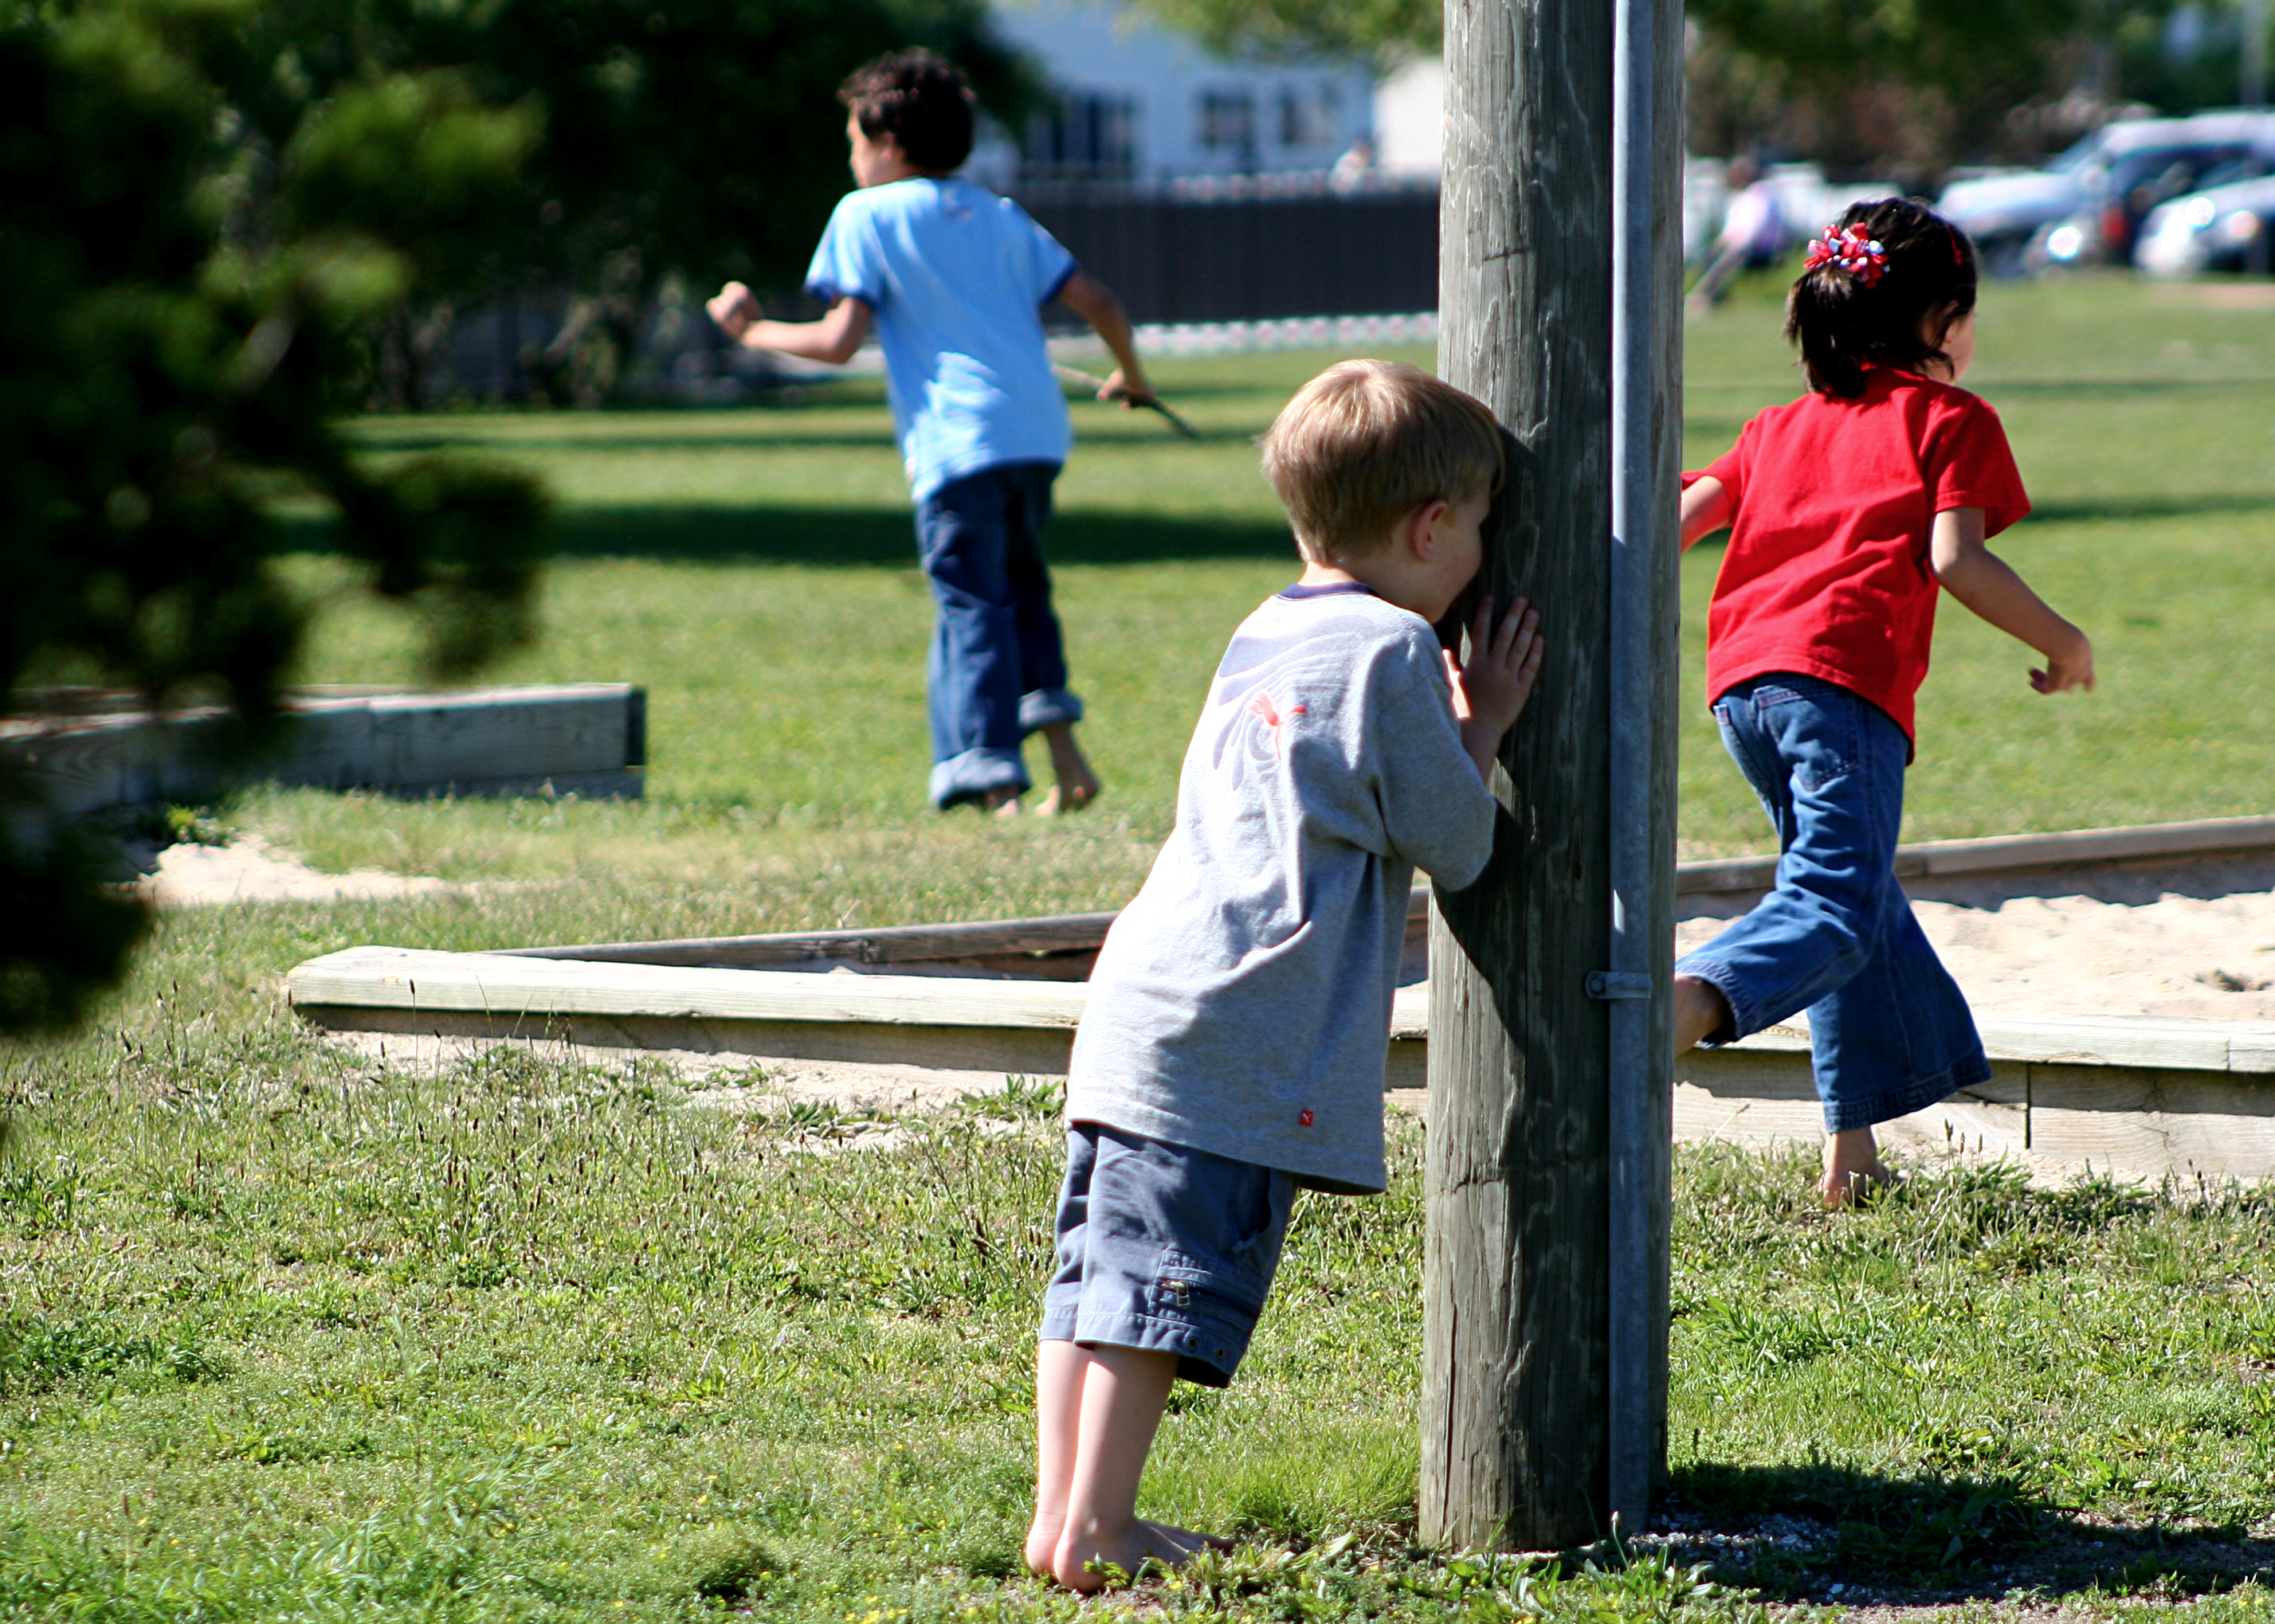
Good SEO
On-page audits – Stop Hiding
Top 10 Results ?
Gated Content ?

Slide 12
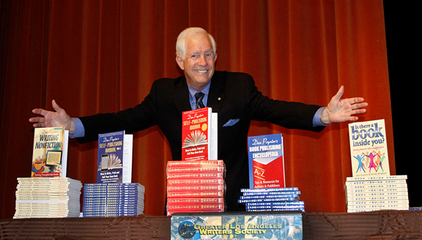
Content Amplification
Two key moments
PPC as appropriate
Influencers & Feedback

Slide 13
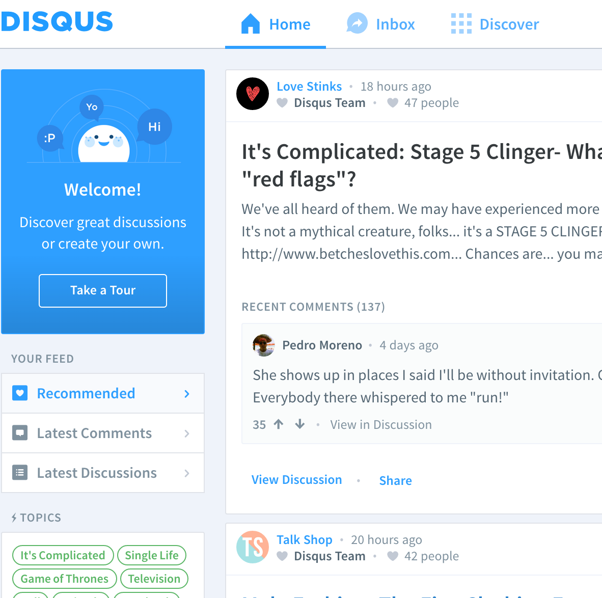
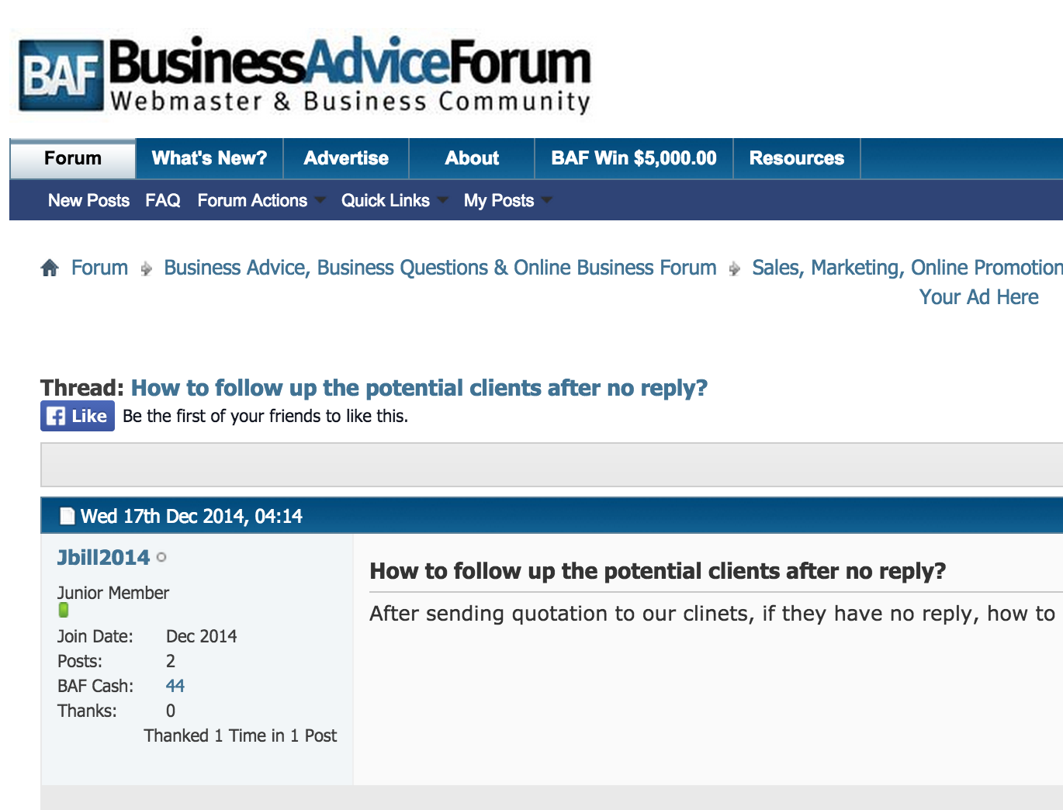
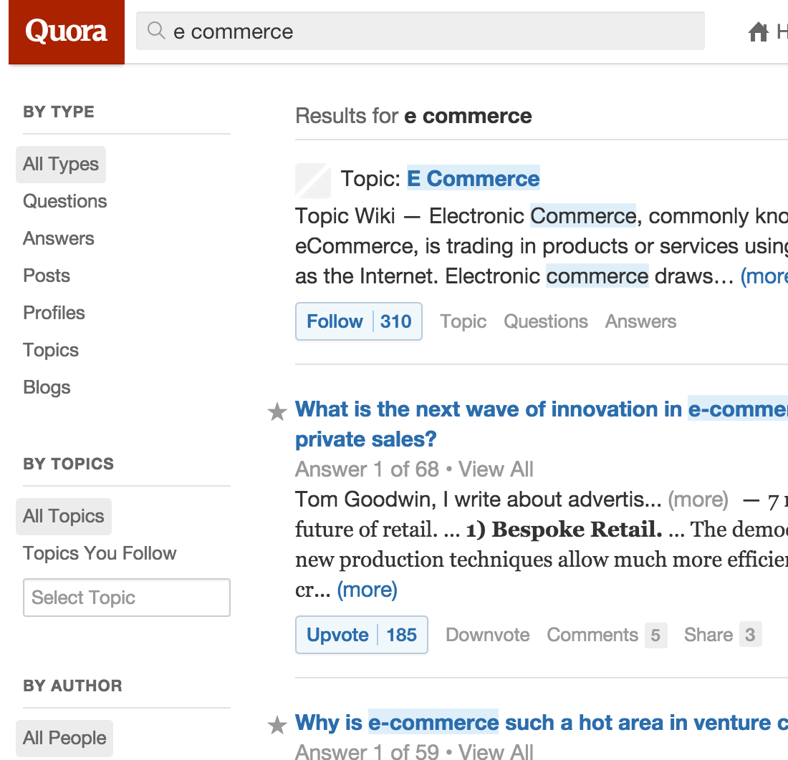
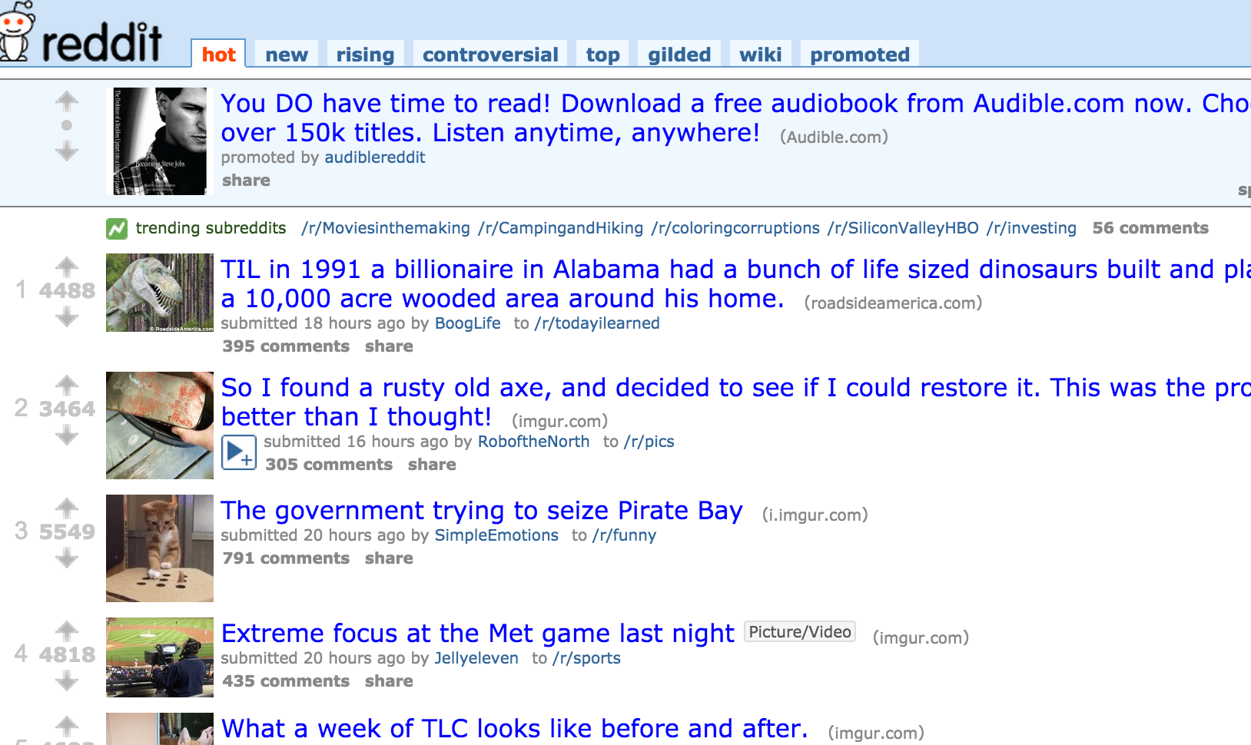
Social Media Marketing

Slide 14
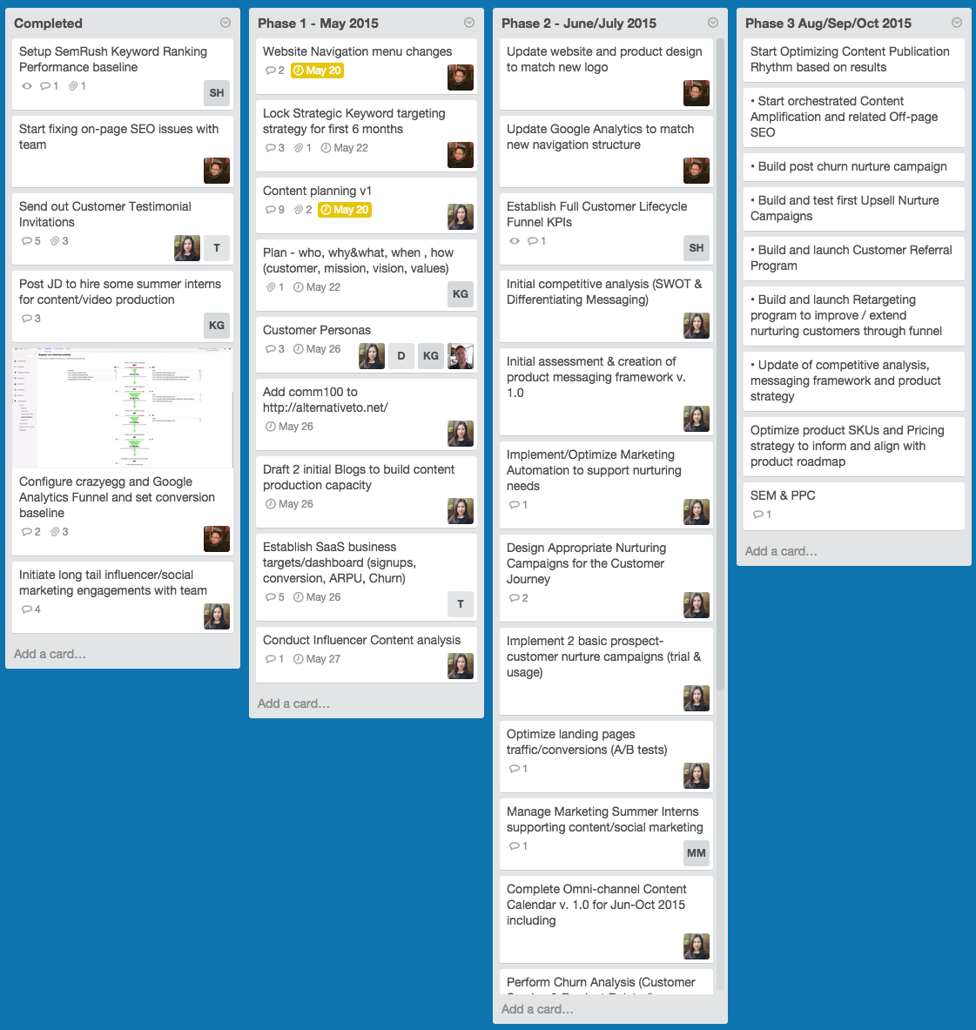
Trello Board Template
Organic Marketing
Interested?
sh@mightycall.com

Slide 15
Q & A
Stijn Hendrikse
@stijnh1

